Slide 1

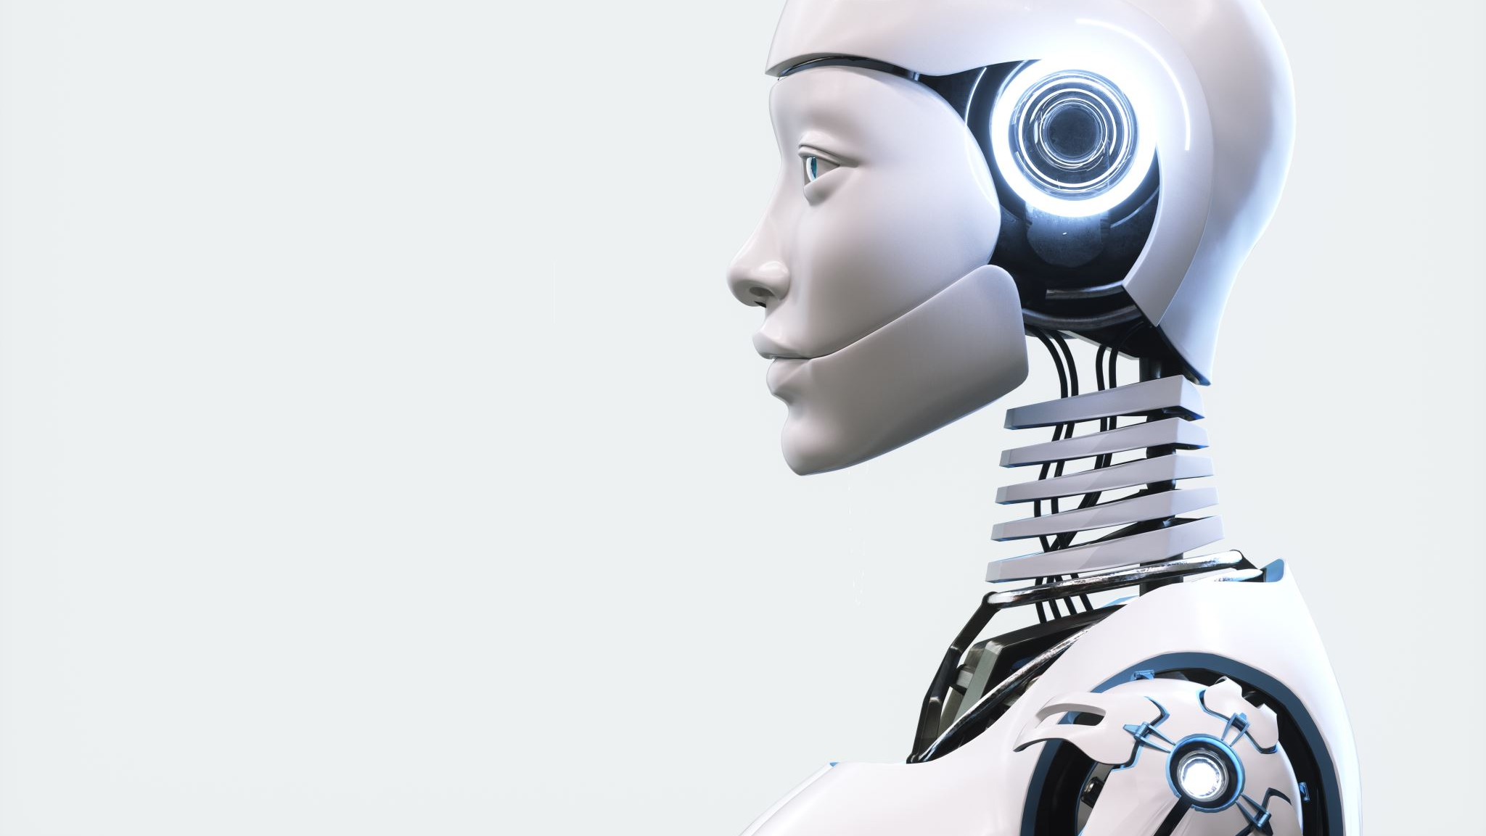
Object detection using machine vision and inverse kinematics
Team Member :
Ahmed Mohamed Gaber 19100683

Slide 2

Without machine vision the robot would be blind only capable of repeating the same exact task over and over until it’s reprogrammed. This technology allows a robot to adjust to obstacles in its environment and complete different preprogrammed tasks.
Problem Discussion:

Slide 3
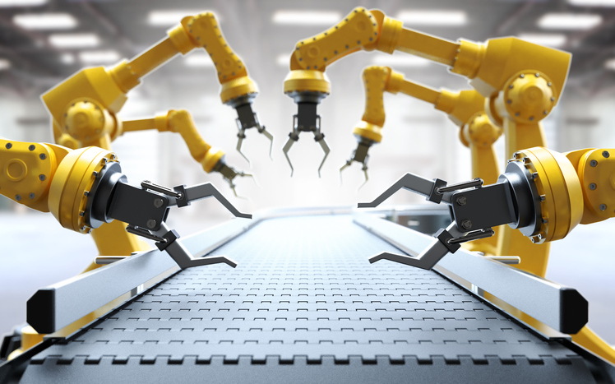
Why our Project is important
Merge between one of the most important fields in industry and robotic field which inverse kinematics and machine vision with them we can build a precise and functional robot.

Slide 4
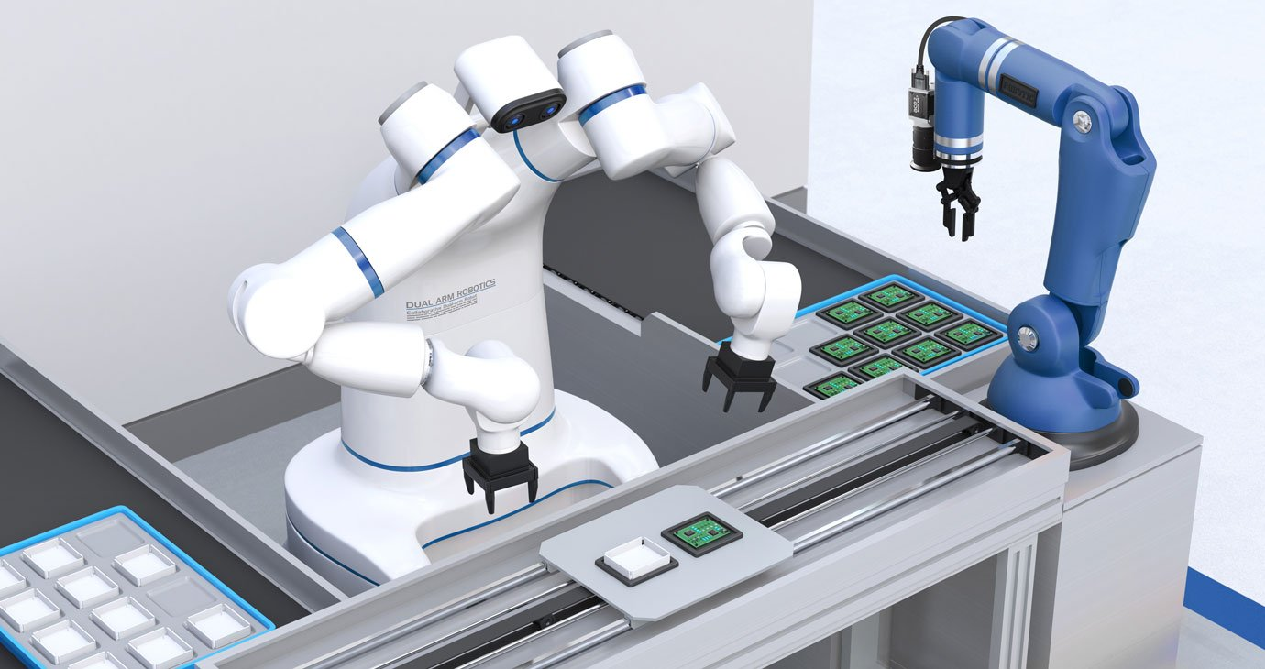
Process and Quality Control
Inspection of parts, metrology, classification, assembly and machine tending - all these applications require imaging for a stable and safe implementation

Slide 5
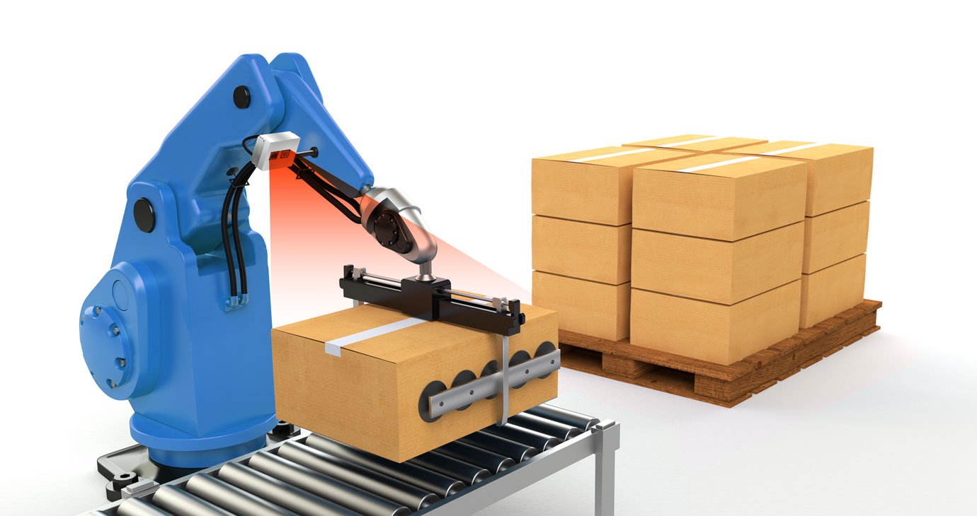
Material Handling and Transport
Vision-guided robotics enable performance of tasks such as pick-and-place, labeling, palletizing, packaging and material transport.
Increased flexibility, optimized collaboration with employees and reliable operation are just some of the possible benefits.

Slide 6

What we need to build our project.
Machine vision.
Inverse kinematics.

Slide 7

Machine vision: Python opencv2
Machine vision Techniques:
Background Subtraction
Color space conversion( color subtraction)

Slide 8

Machine vision:
1- Input image from camera
2- Blurring and diluting image to decrease noise
3- Adaptive region identification using color subtraction(choose range of color detected ignore rest of colors)
4- Detect borders of object using contours.
5- Draw rectangle around object detected

Slide 9
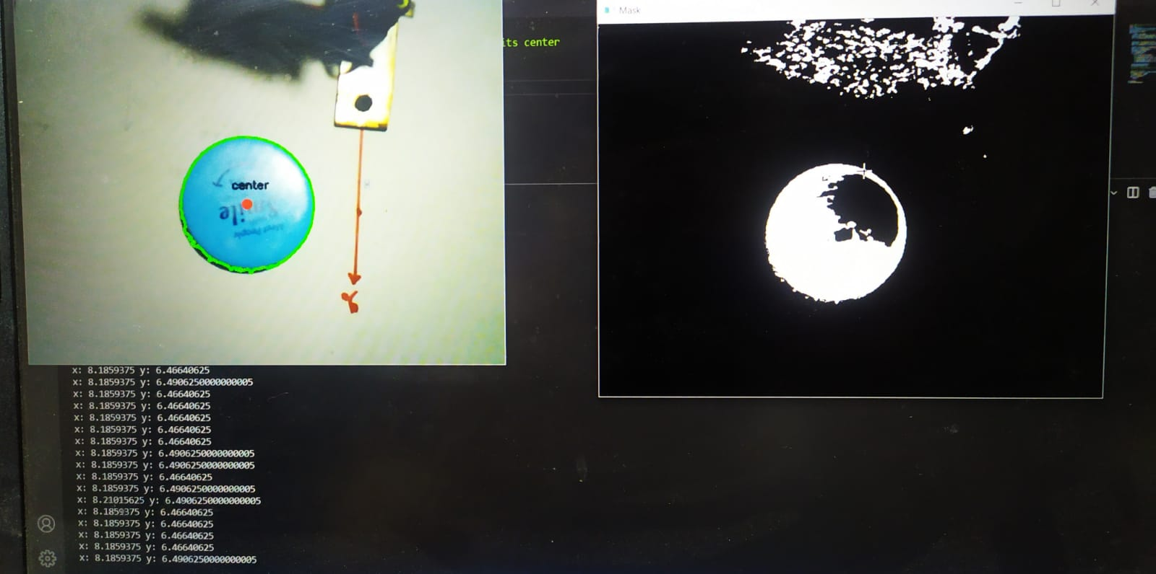
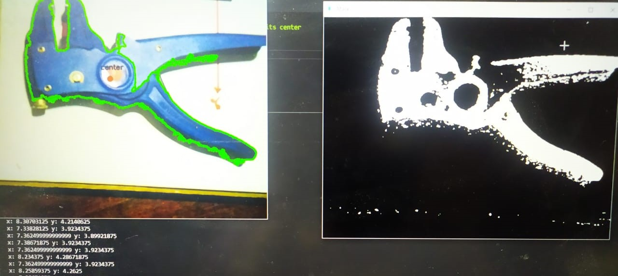

Slide 10

Inverse kinematics: Most important topic in robotic field
Inverse kinematics is the use of kinematic equations to determine the angles of motor needed to reach a desired position. Where it needs lots of math and trigonometric equations
For example, to perform automated bin picking, a robotic arm used in a manufacturing line needs precise motion from an initial position to a desired position between bins.

Slide 11
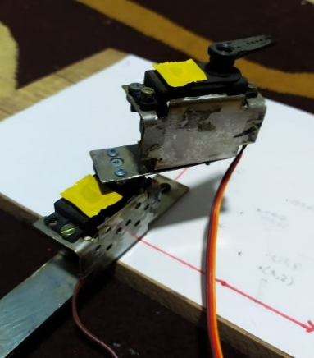
How I build the 2DOF manipulator
We used:
2 Servo motors 13kg/cm
Arduino uno
Metal bracket
Camera
Wood base

Slide 13
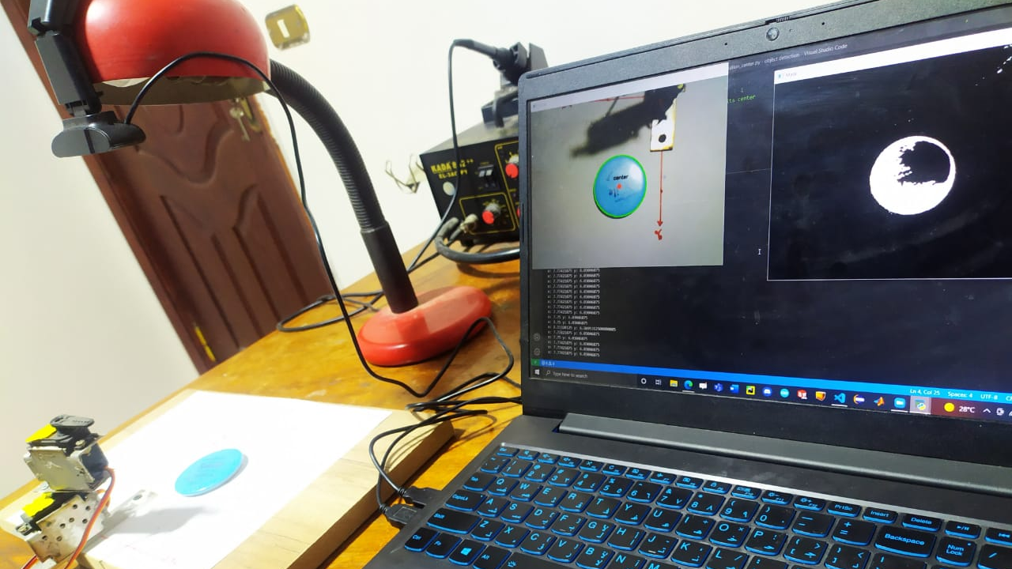

Slide 14

Finally, The most awaited part

Slide 15
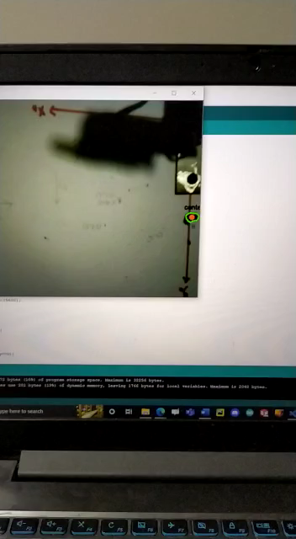
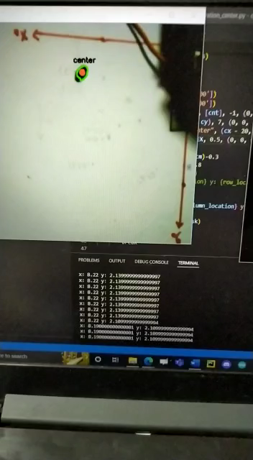

Slide 16

Thank you

